Slide 1
Software Engineering
Chapter 8
Software Design Quality
Learning Outcomes
  Understand the principles of good design
  Ability to assess a software design
  Understand the choices for Software Architecture
Text: Bruegge & Dutoit Chapter 6
Sommerville
Notes:
Things you should look up:
Pressman - chapter’s 1 & 2

Slide 2

Design strategies
Functional design
  The system is designed from a functional viewpoint
    Start with high level view and refine into more detail
      e.g. Structured Design, SSADM*, step-wise refinement, Jackson Structured Programming...
Object-oriented design
  The system is viewed as a collection of interacting objects.
  Objects may be instances of an object class and communicate by calling methods. e.g. UML
Which one?
  Select the most appropriate approach for whatever
  sub-system is being designed
*Structured Systems Analysis and Design Method

Slide 3
Design quality
What is a ‘good’ design?
  A 'good' design may be the most efficient, the cheapest, the most maintainable, the most reliable, etc...
We will concern ourselves mainly with maintainability and reusability
A design should...
  be modular - i.e. software partitioned into modules
  that perform certain functions
  have distinct and separable representation of data and procedure
  lead to modules that have independent functions
  be derived according to a repeatable method that is driven by the requirements specification

Slide 4
Abstraction
‘The psychological notion of “abstraction” permits one to concentrate on a problem at some level of generalisation without regard to irrelevant
low-level details’
e.g. Develop software that will perform 2-D drafting (CAD)
Abstraction 1
  Software will include a computer graphics interface which will enable the draftsperson to see a drawing and to communicate with it via a mouse.
  All line and curve drawing, geometric computations.... will be performed by the CAD software.
  Drawings will be stored in a drawings file.
Abstraction 2
  CAD software tasks:
    user interaction task;
    2-D drawing task;
    graphics display task;
    drawing file management task;
  end.
= Procedural Abstraction

Slide 5
Abstraction contd
Data Abstraction: defining a data object at different levels
e.g. A Drawing
Abstraction 1: drawing
Abstraction 2:
TYPE drawing IS STRUCTURE DEFINED
number IS STRING LENGTH(12)
geometry IS DEFINED...
notes IS STRING LENGTH(256)
END drawing TYPE;
This is an abstract
data type (ADT)
This is another abstract data type

Slide 6
Modularity
Software is divided into separately named, addressable modules
(at the lowest level these modules may be individual software classes and objects)
The complexity of a program depends on its modularity
Let C(x) = a measure of complexity and p1 and p2 be problems
and Let E(x) a measure of Effort to Solve
  If C(p1) > C(p2) then it follows by experience
  E(p1) > E(p2)
  In addition C(p1+p2) > C(p1) + C(p2)
  Therefore E(p1+p2) >E(p1) + E(p2)
How small should modules be? (We’ll see...)
Moral: ‘Divide and Conquer’
Interface cost
Total cost
Cost of Effort
Cost per module
No. modules

Slide 7
More fundamental concepts
Data Structure
  A representation of a logical relationship among individual data elements
Software Procedure
  The processing details of a module
Information Hiding
  Modules should be characterised by design decisions that cause their information to be hidden from other modules
    i.e. modules should be designed so that no other modules can access their data or their procedures unless they need to.
  Why? - When it comes to adapting a module or maintaining an individual module, there is less possibility for inadvertent errors
  Functional independence: abstraction and modularity lead to modules that are ‘single-minded’, and again easier to adapt and maintain, so that we achieve...
Adaptability
Understandability

Slide 8
Coupling and Cohesion
Cohesion: how well does a module fit together
Coupling: how dependent is one module on another
Cohesion is good
Coupling is bad
Why?
What sort of things cause
poor cohesion/high coupling?
Module Y
Coupling
Module X
(Cohesion)
Module Z

Slide 9
Cohesion
Interaction within a module is a measure of how well that module 'fits together'
High cohesion: the module implements a single logical entity or function
Cohesion is a desirable quality
  when a change has to be made,
  it is localised within a single module
Why is this good?
  Ease of maintenance
  Possibility of reuse
  The name of the module easily expresses what it does
  The complexity of the interface is reduced

Slide 10
Cohesion levels
Coincidental cohesion (weak)
  Parts of a module are simply bundled together.
    The module is difficult to maintain
    It offers little or no reusability
    In these circumstances modularity offers little advantage
Logical association (weak)
  Elements which perform similar functions are grouped
    The interface is difficult to understand
    The module is difficult to maintain if code for individual tasks
    is related or interconnected
Temporal cohesion (weak)
  Elements which are activated at the same time are grouped
    Tasks may not be not related, so if changes are to be made in this module, other modules may have to be changed also.
    The module’s name may not adequately describe its purpose

Slide 11
Cohesion levels
Procedural cohesion (weak)
  The elements in a module constitute a single control sequence
    Better than temporal cohesion, since all the module’s
    operations are at least logically related, but reusability is limited because
      The single control sequence might relate to a very particular set of circumstances and the sequence of interaction between the elements in the module
      may be unclear
      Since all elements of the module do not necessarily deal with the same data, it may be difficult to maintain the broader system interface to the module
Communicational cohesion (medium)
  All the elements of a module operate
  on the same input or produce the same output
    Better than procedural cohesion, since the module has a clear interface to the broader system, and there is a clear interface between the elements within the module
    But the module may still lack...
Sequential cohesion (medium)
  The output from one part of a module is the input to another part

Slide 12
Cohesion levels
Functional cohesion (strong)
  Each element of a module is necessary for the execution of a single function
Object cohesion (strong)
  Each method within the module (which is a software object) provides functionality which allows object attributes to be modified or inspected

Slide 13
Coupling
A measure of the strength of the interconnections between system modules
Loose coupling means module changes are unlikely to affect other modules
Shared variables or control information exchange lead to tight coupling
Loose coupling can be achieved by state decentralisation (as in objects) and module communication via parameters or message passing (= method calls)
28

Slide 14
Levels of coupling
Good Practice
  Data coupling: data is passed from one module to another using arguments in methods
Bad Practice
  Stamp coupling: more data than necessary is passed via arguments – e.g. pass the whole record instead of just the field being changed
  Control coupling: a flag is passed from one module to another affecting the functionality of the second module
    modules are not independent and so reuse is limited
    the calling module must ‘know’ how the called module works

Slide 15
Levels of coupling
Bad Practice, contd
  Common Coupling: two or more modules access the
  same global (or shared) data
    The resulting code is difficult to read
    There may be side-affects: has another module changed a variable?
    Programs are costly to maintain as a change to a global variable means the whole program has to be searched to find its effect
    Reusability is poor
    Security problems: each module has access to more data than it needs
Module A
Module B
Module C
Module D
Shared Data Area

Slide 16
Levels of coupling
Bad practice, contd
  Content coupling: the calling module can directly modify
  or refer to a data element defined internally in the called module
    Makes maintenance very difficult,
    as the program will be difficult to understand.
    Hint: never allow this type of coupling!
Global data area
A
Content
Coupling
Common Coupling
B
C
D
E

Slide 17

UML to Design
Remember – analysis / early design
produced different models:
  A class diagram – showing the classes in the system
  A dynamic model – comprising state diagrams, sequence diagrams, and use-cases
Detailed design
  ... is concerned with designing algorithms or methods
  In designing methods, a number of points may be considered
    Which one is cheapest to implement?
    Which data structures might the method manipulate or create?
    Will new classes (intermediate results) have to be defined to support the method?

Slide 18
UML to Design
Detailed design may also involve
  Design optimisation: refining methods for efficiency
  Adjustment of inheritance: abstracting common behaviour out of groups of classes – i.e. inheritance opportunities missed in the earlier class diagrams
  Information hiding - finessing the design to ensure that:
    classes are black boxes whose external interface is public but whose internal details are hidden;
    objects’ states may be changed without unnecessarily affecting other objects;
    attributes that should be accessible to other objects are public and those which shouldn’t be are private

Slide 19
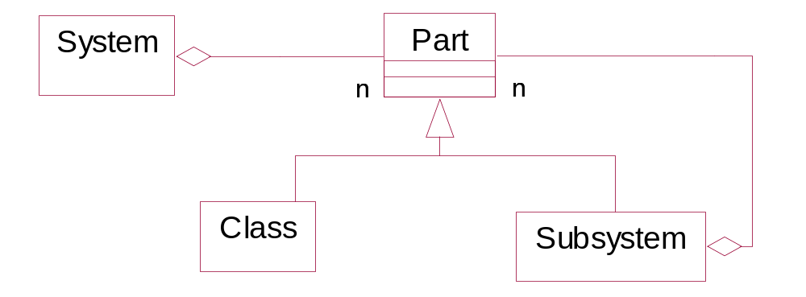
Systems and Subsystems
Division of a system into subsystems
  Increases understanding
  Increases reusability
  Allows assignment of responsibility to different members of a development team

Slide 20
Subsystem decomposition e.g. Emergency response system
FieldOfficerInterface
DispatcherInterface
MapManagement
dependency
IncidentManagement
ResourceManagement
Notification
Each subsystem provides a service
The interface to the subsystem must be defined
  e.g. API = application programming interface

Slide 21
Software Architecture
Describing the structure of a system, its major modules and how they communicate
Before detailed design we need
  a model showing subsystems/modules
  a model showing how the system behaves
  a model showing how to interface to each sub-system
Some examples follow

Slide 22
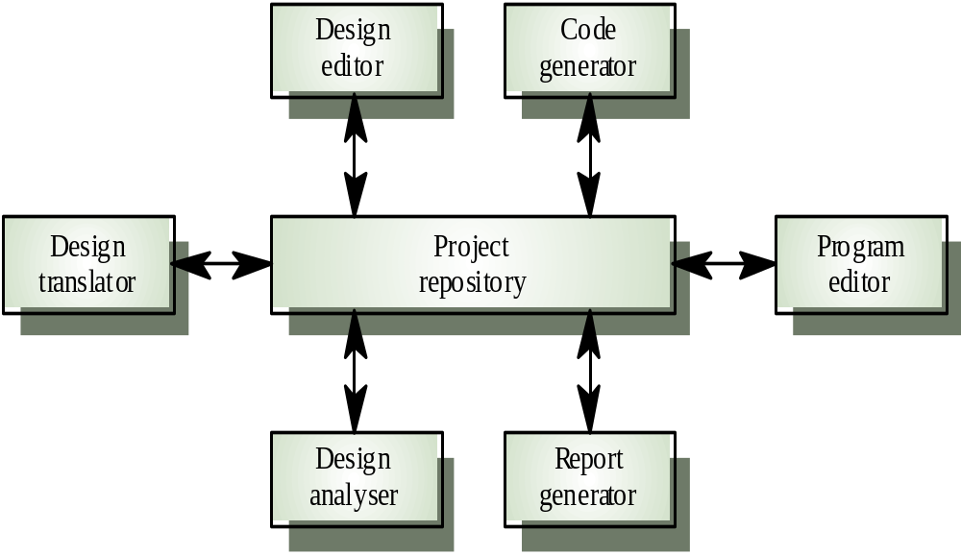
Repository Model
Advantages
Efficient way to share large amounts of data
Sub-systems need not be concerned with how data is produced
Centralised management e.g. backup, security, etc.
  Sharing model is published as the repository schema
Disadvantages
Sub-systems must agree on a repository data model: inevitably a compromise
Data evolution is difficult and expensive
Difficult to distribute efficiently

Slide 23
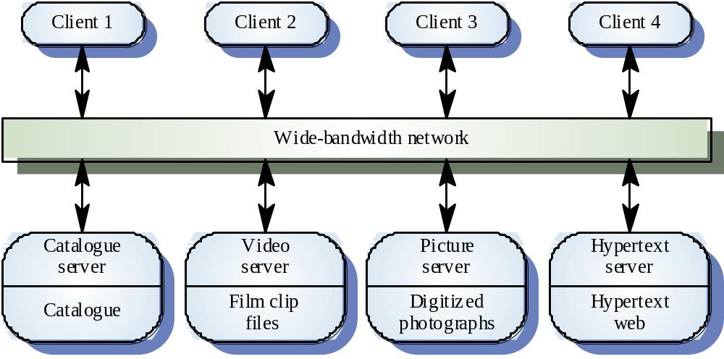
Client Server Model

Slide 24
Client Server Model
Advantages
  Distribution of data is straightforward
  Makes effective use of networked systems
  Easy to add new servers or upgrade existing servers
Disadvantages
  No shared data model, so sub-systems may use different data organisation
  Data interchange may be inefficient
  Redundant management in each server
  No central register of names and services - it may be hard to find out what servers and services are available

Slide 25
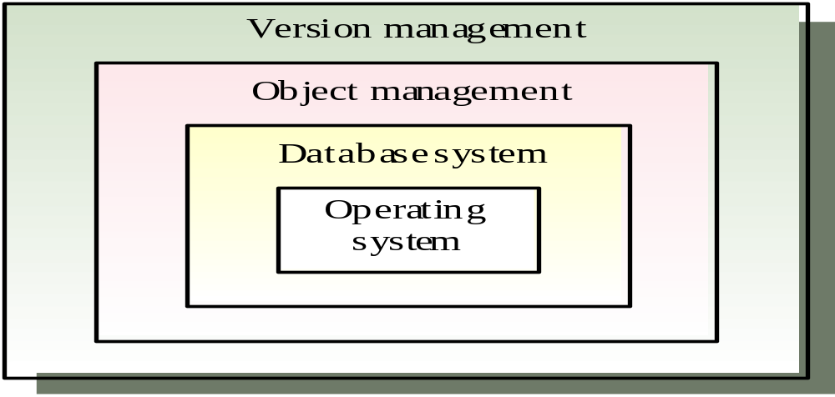
Abstract machine model
Used to model the interfacing of sub-systems
Organises the system into a set of layers (or abstract machines) each of which provides a set of services
  When a layer interface changes, only the adjacent layer is affected e.g. version management system

Slide 26
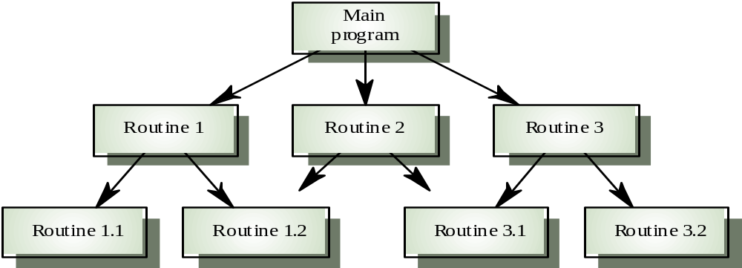
Control models - centralised control
A control sub-system takes responsibility for managing the execution of other sub-systems
Call-return model
  Top-down subroutine model where control starts at the top of a subroutine hierarchy and moves downwards.

Slide 27
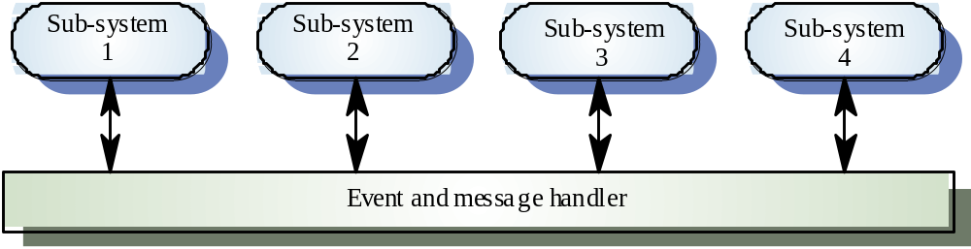
Event-driven systems – broadcast driven
Different sub-systems on a network
Sub-systems register an interest in specific events
When these occur, control is transferred to the sub-system
that can handle the event
The event is then handled

Slide 28
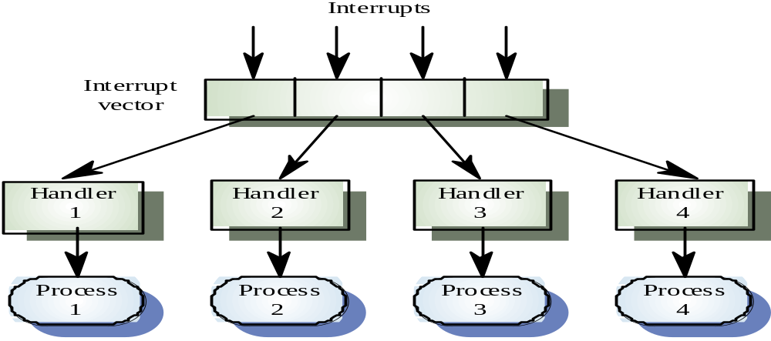
Event-driven systems – interrupt driven
real-time systems - fast response is essential
  Known interrupt types, each with a handler, are defined
  Each type is associated with a memory location, and a hardware switch causes transfer to its handler

Slide 29
Distributed systems architectures
Distributed object architectures
  No distinction between clients and servers.
  Any object on the system may provide and use
  services from other objects
...contrast with client-server architectures
  Distributed services which are called on by clients.
  Servers that provide services are treated differently from clients that use services

Slide 30
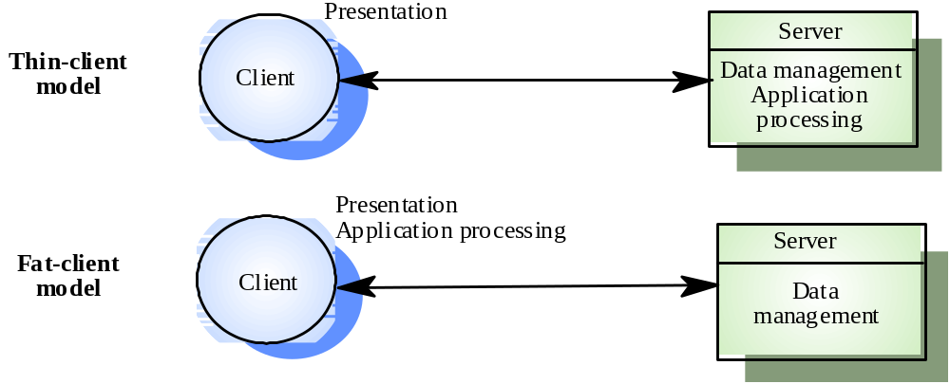
Thin and fat clients
Thin-client model
  In a thin-client model, all of the application processing and data management is carried out on the server. The client is simply responsible for running the presentation software.
Fat-client model
  In this model, the server is only responsible for data management. The software on the client implements the application logic and the interactions
  with the system user.

Slide 31
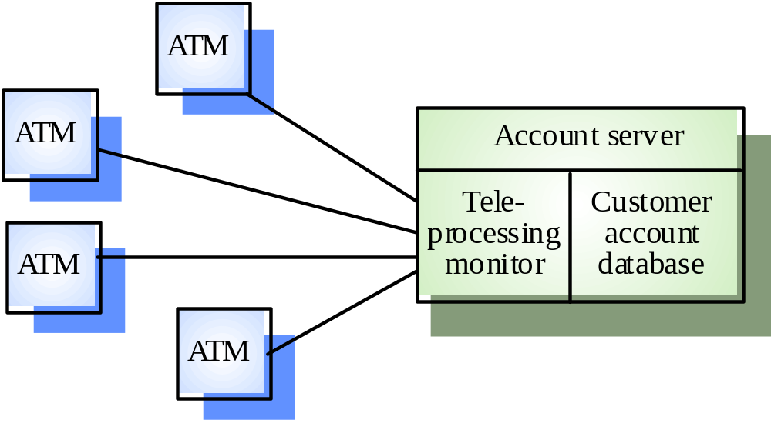
A client-server ATM system

Slide 32
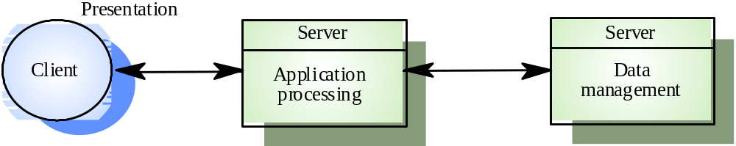
Three-tier architectures
In a three-tier architecture, each of the application processing layers may execute on a separate processor
Allows for better performance than a thin-client approach and is simpler to manage than a fat-client approach
A more scalable architecture - as demands increase, extra servers can be added

Slide 33
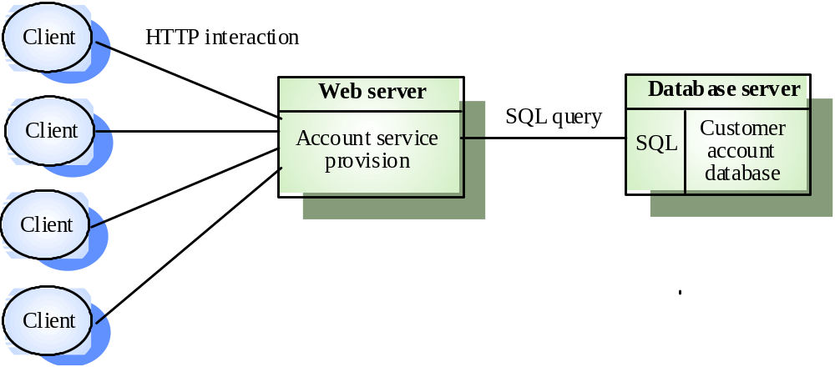
An internet banking system

Slide 34
Distributed object architecture
There is no distinction between clients and servers
Each distributable entity is an object that provides services to other objects and receives services
from other objects
Object communication is through a middleware system called an object request broker (software bus)
However, this is more complex to design than client-server systems

Slide 35
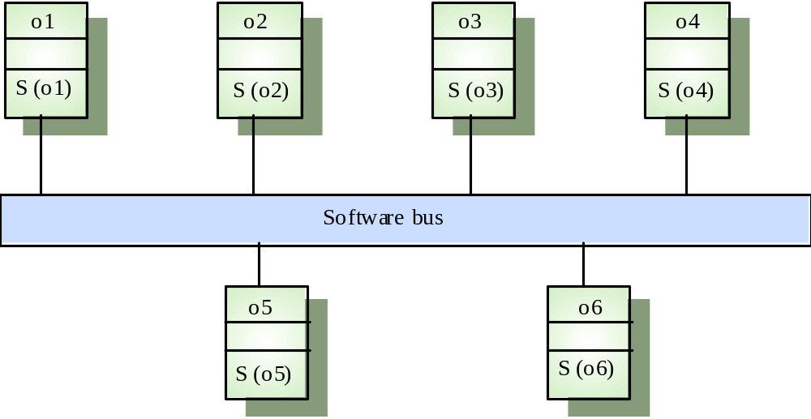
Distributed object architecture

Slide 36
Advantages of Distributed Object Architecture
A distributed object architecture allows the system designer to delay decisions on where and how services should be provided
It is a very open system architecture that allows new resources to be added to it as required
The system is flexible and scaleable
It is possible to reconfigure the system dynamically with objects migrating across the network as required

Slide 37
Software Engineering
Chapter 8
Software Design Quality
Learning Outcomes
  Understand the principles of good design
  Ability to assess a software design
  Understand the choices for Software Architecture
Text: Bruegge & Dutoit Chapter 6
Sommerville
Notes:
Things you should look up:
Pressman - chapter’s 1 & 2

